Slide 1
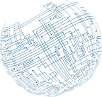



Virtualization
and Cloud Security

Slide 2
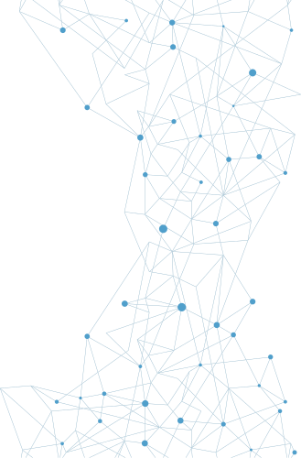

Cloud
Models
Infrastructure as a Service (IaaS) is a marketing term used to describe cloud-based systems that are delivered as a virtual solution for computing. Rather than firms needing to build data centers, IaaS allows them to contract for utility computing as needed. IaaS is specifically marketed on a pay-per-use basis, scalable directly with need.

Slide 3
Cloud
Models
Platform as a Service (PaaS) is a marketing term used to describe the offering of a computing platform in the cloud. Multiple sets of software working together to provide services, such as database services, can be delivered via the cloud as a platform.

Slide 4
Cloud
Models
Software as a Service (SaaS) is the offering of software to end users from within the cloud. Rather than installing software on client machines, SaaS acts as software on demand, where the software runs from the cloud.

Slide 5
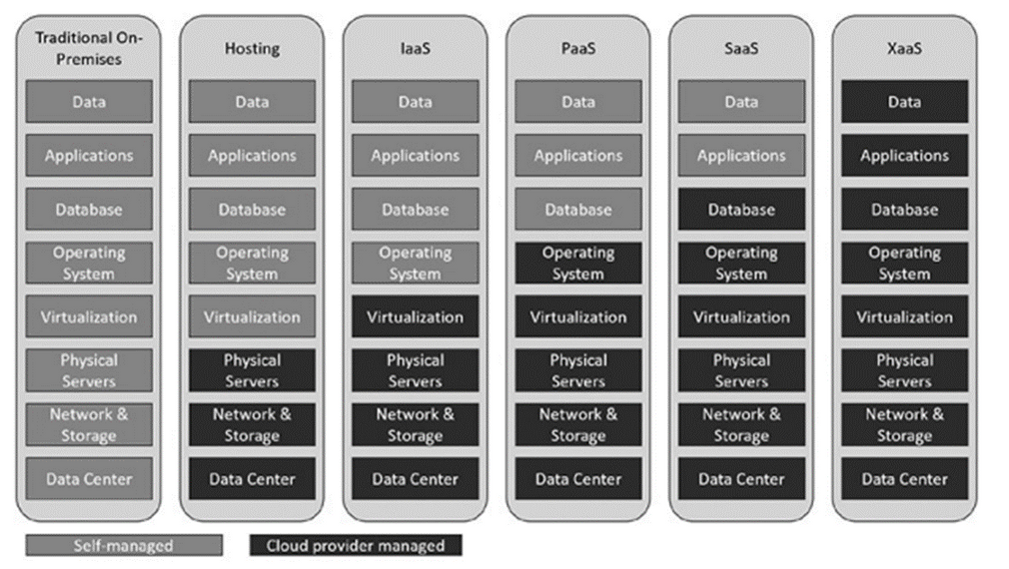
Cloud
Models
With the growth of cloud services, applications, storage, and processing, the scale provided by cloud vendors has opened up new offerings that are collectively called Anything as a Service (XaaS).

Slide 6
Cloud
Models
The term public cloud refers to a cloud service that is rendered over a system open for public use. In most cases, there is little operational difference between public and private cloud architectures, but the security ramifications can be substantial.

Slide 7
Cloud
Models
A community cloud system is one where several organizations with a common interest share a cloud environment for the specific purposes of the shared endeavor

Slide 8
Cloud
Models
Private clouds are essentially reserved resources used only by an organization.
A hybrid cloud structure is one where elements from private, public, and community cloud structures are combined.

Slide 9
Cloud
Service Providers
Cloud service providers (CSPs) come in many sizes and shapes, with a myriad of different offerings, price points, and service levels. There are the mega-cloud providers, Amazon, Google, Microsoft, and Oracle, which have virtually no limit to the size they can scale to when needed.

Slide 10
MSP/
MSSP
A managed service provider (MSP) is a company that remotely manages a customer’s IT infrastructure.
A managed security service provider (MSSP) does the same thing as a third party that manages security services.

Slide 11
On-Premises
vs Off-Premises
On-premises means the system resides locally in the building of the organization.
Off-premises or hosted services refer to having the services hosted somewhere else, commonly in a shared environment.

Slide 12
Fog
Computing
Fog computing is a distributed form of cloud computing, in which the workload is performed on a distributed, decentralized architecture.

Slide 13
Thin
Client
A thin client is a lightweight computer, with limited resources, whose primary purpose is to communicate with another machine. Thin clients can be very economical when they are used to connect to more powerful systems.

Slide 14
Containers
Virtualization enables multiple OS instances to coexist on a single hardware platform. The concept of containers is similar, but rather than having multiple independent OSs, a container holds the portions of an OS that it needs separate from the kernel.

Slide 15
Infrastructure
as Code
Infrastructure as code is the use of machine-readable definition files as well as code to manage and provision computer systems

Slide 16
Infrastructure
as Code
Software-defined networking (SDN) is a network architecture where the control plane and the data plane are separated. This allows for networking hardware to be under programmatic control, even while processing data.

Slide 17
Serverless
Architecture
In serverless architecture, by specifying the resources needed in terms of processing power, the cloud provider can spin up the necessary resources.

Slide 18
Services
Integration
Services integration is the connection of infrastructure and software elements to provide specific services to a business entity. Connecting processing, storage, databases, web, communications, and other functions into an integrated comprehensive solution is the goal of most IT organizations.

Slide 19
Resource
Policies
When specifying the details of a cloud engagement – how much processing power, what apps, what security requirements, how much storage, and access control are all resources. Management of these items is done via resource policies.

Slide 20
Transit
Gateway
A transit gateway is a network connection that is used to interconnect virtual private clouds (VPCs) and on-premises networks. Using transit gateways, organizations can define and control communication between resources on the cloud provider’s network and their own infrastructure.

Slide 21
Virtualization
Virtualization technology is used to enable a computer to have more than one OS present and, in many cases, operating at the same time.
A hypervisor is a low-level program that allows multiple operating systems to run concurrently on a single host computer.

Slide 22
Virtualization
Type II hypervisors run on top of a host operating system.
EXAMPLE: Oracle VirtualBox

Slide 23
Thank
You

